Slide 1
Town of Mazomanie
Comprehensive Land Plan – 2024
Public Hearing
October 10th, 2024

Slide 2
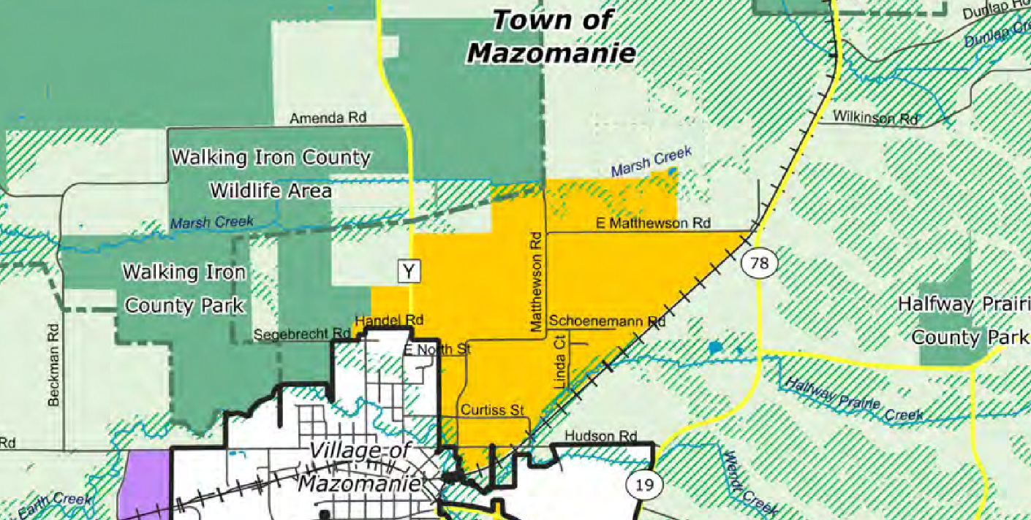
Why Neighborhood Development Areas?

Slide 3
Top 3 Revenue Sources
2025 Levy = $241,000
Shared Revenue, Transportation Aid = $244,000
Transfer Site =$120,000
Levy: 5% Yearly Decrease

Slide 4
Top Expenses
Highway Expenses: $115,000
Transfer Site: $97,000
Highway Construction: $90,000
EMS: $56,000 (doubling trend)
Fire: $42,000
Fire Truck Loan (until 2025): $26,000
Plow Truck Loan (until 2030): $24,000
Annual Equipment Budget: $20,000
EMS: 80% Yearly Increase

Slide 5
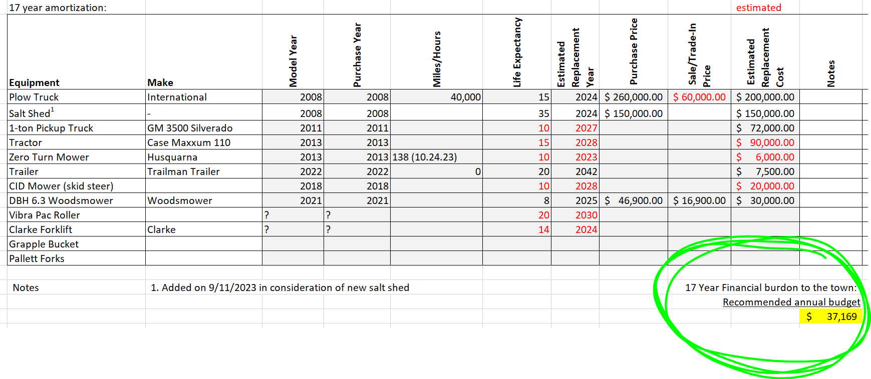
Equipment Amortization (we have a plan)

Slide 6
Fire Truck
Black Earth Fire Truck – Due in 2028
Estimated Cost – $1.008M
Distributed Amongst 5 Municipalities - $250,000 each
Estimated Annual Cost - $37,000

Slide 7
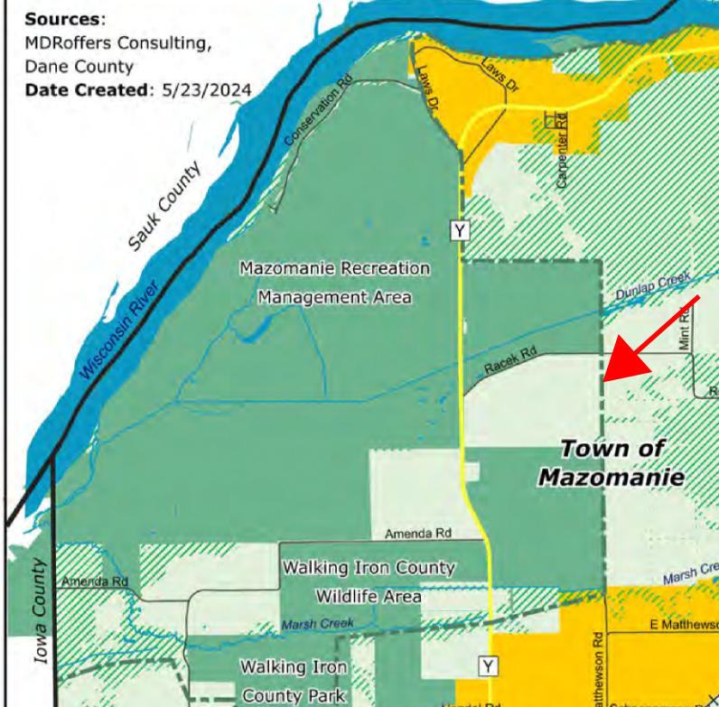
DNR & Dane County
Currently own 33% of property in Town of Mazomanie
Anticipated growth (see image)
Dane County does NOT pay property taxes
DNR pays PILT amount of xxx/year.

Slide 8
Budget Projection

Slide 9
Savings Account

Slide 10
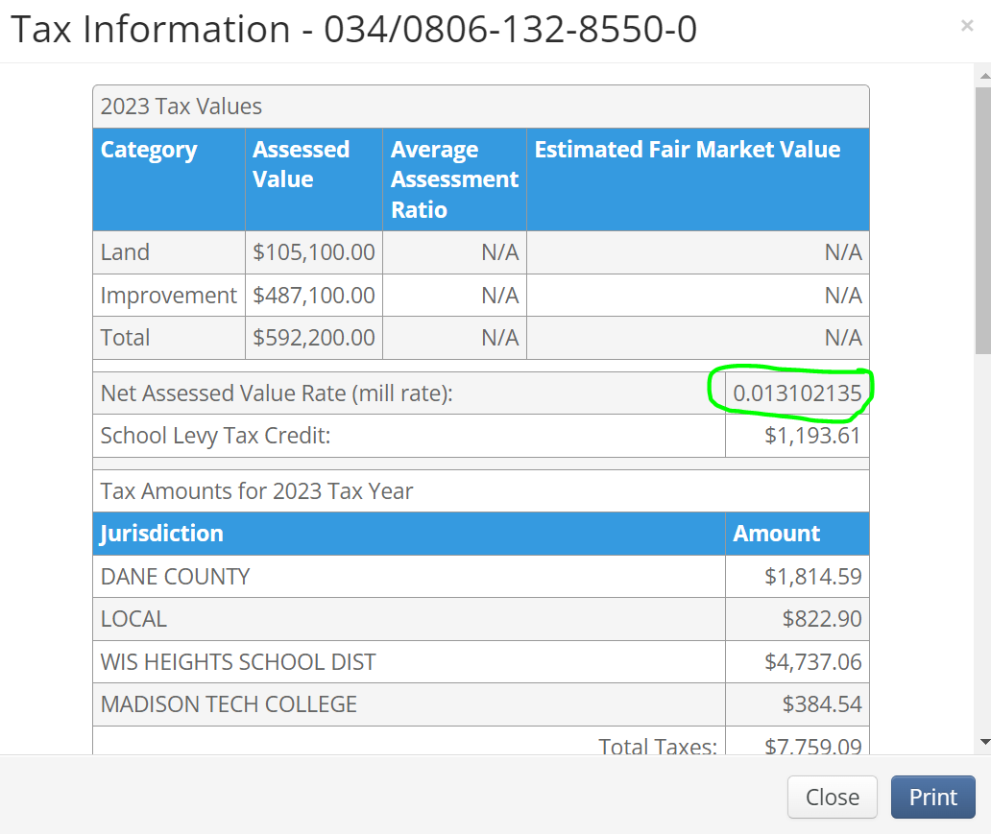
https://dcimapapps.countyofdane.com/dcmapviewer/

Slide 11
Mill Rate
$13 per thousand of taxable value (assessment)
So, a property assessed at $800,000 pays $10,500 in taxes.
Mazomanie receives 11% of the mill rate, so $1,153
This is what makes the levy of $241,000
If a 40 acre parcel develops 25 properties, this equates to: $28,800

Slide 12
Schools
Funding per K-8 Student: $9,893
Funding per 9-12 Student: $12,387
25 SFH’s x 1.6 children/family = 40 Children x $11,135 ^{(average per child)} =
$445,000
https://docs.legis.wisconsin.gov/misc/lfb/misc/182_2023_24_general_school_aids_amounts_for_all_school_districts_11_9_23.pdf

Slide 13
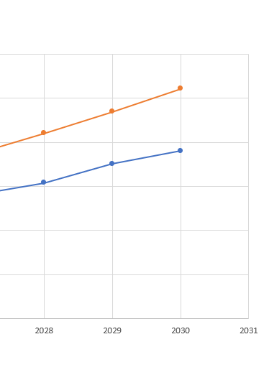
Levy Increase – Worst Case
$100,000
deficit
$13 to $17
$800,000 x 0.013 = $10,400
$800,000 x 0.017 = $14,200
Increase = $3,800

Slide 14
Summary
Approaching a fiscal challenge
EMS
Fire
Equipment
Other towns are 1 to 2 years from issues
We have time, but need to solve these challenges

