Slide 1
Draft Town of Mazomanie Comprehensive Plan Public Hearing

Slide 4
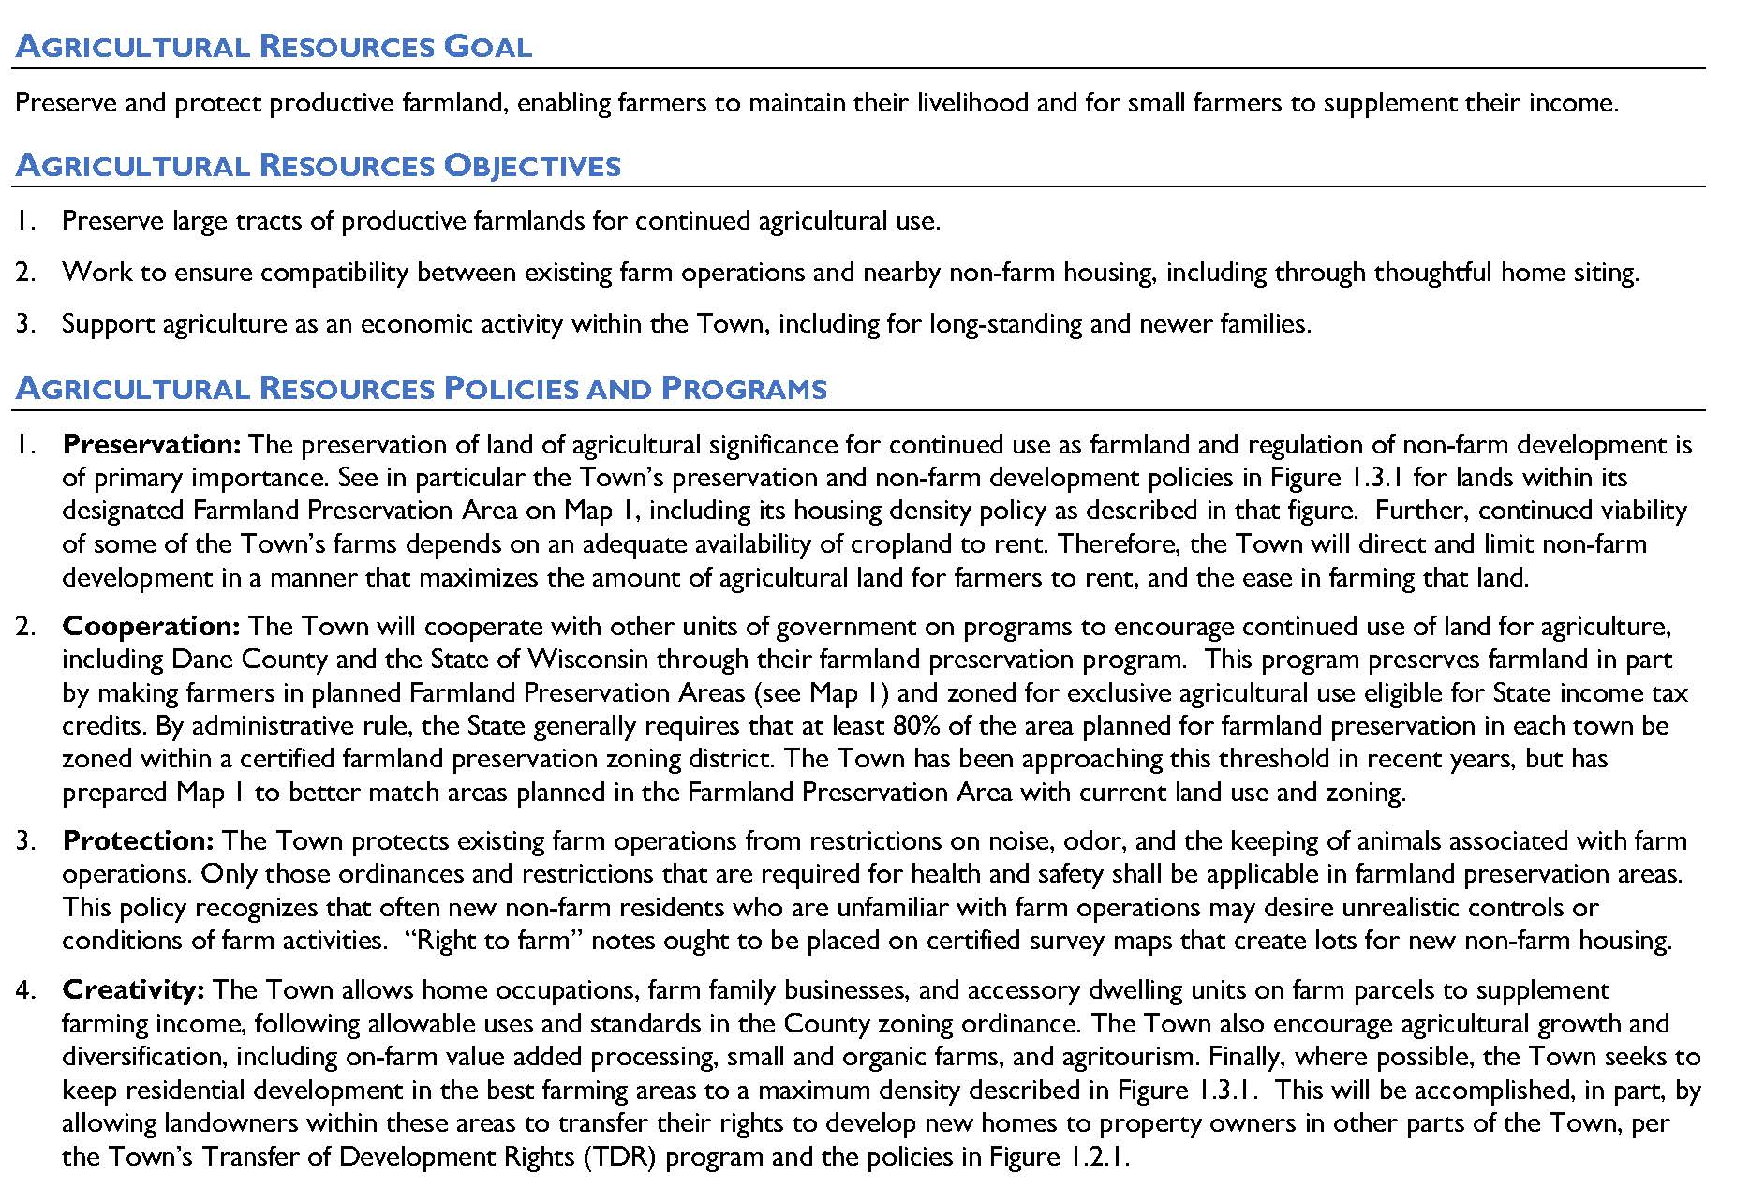

Slide 6
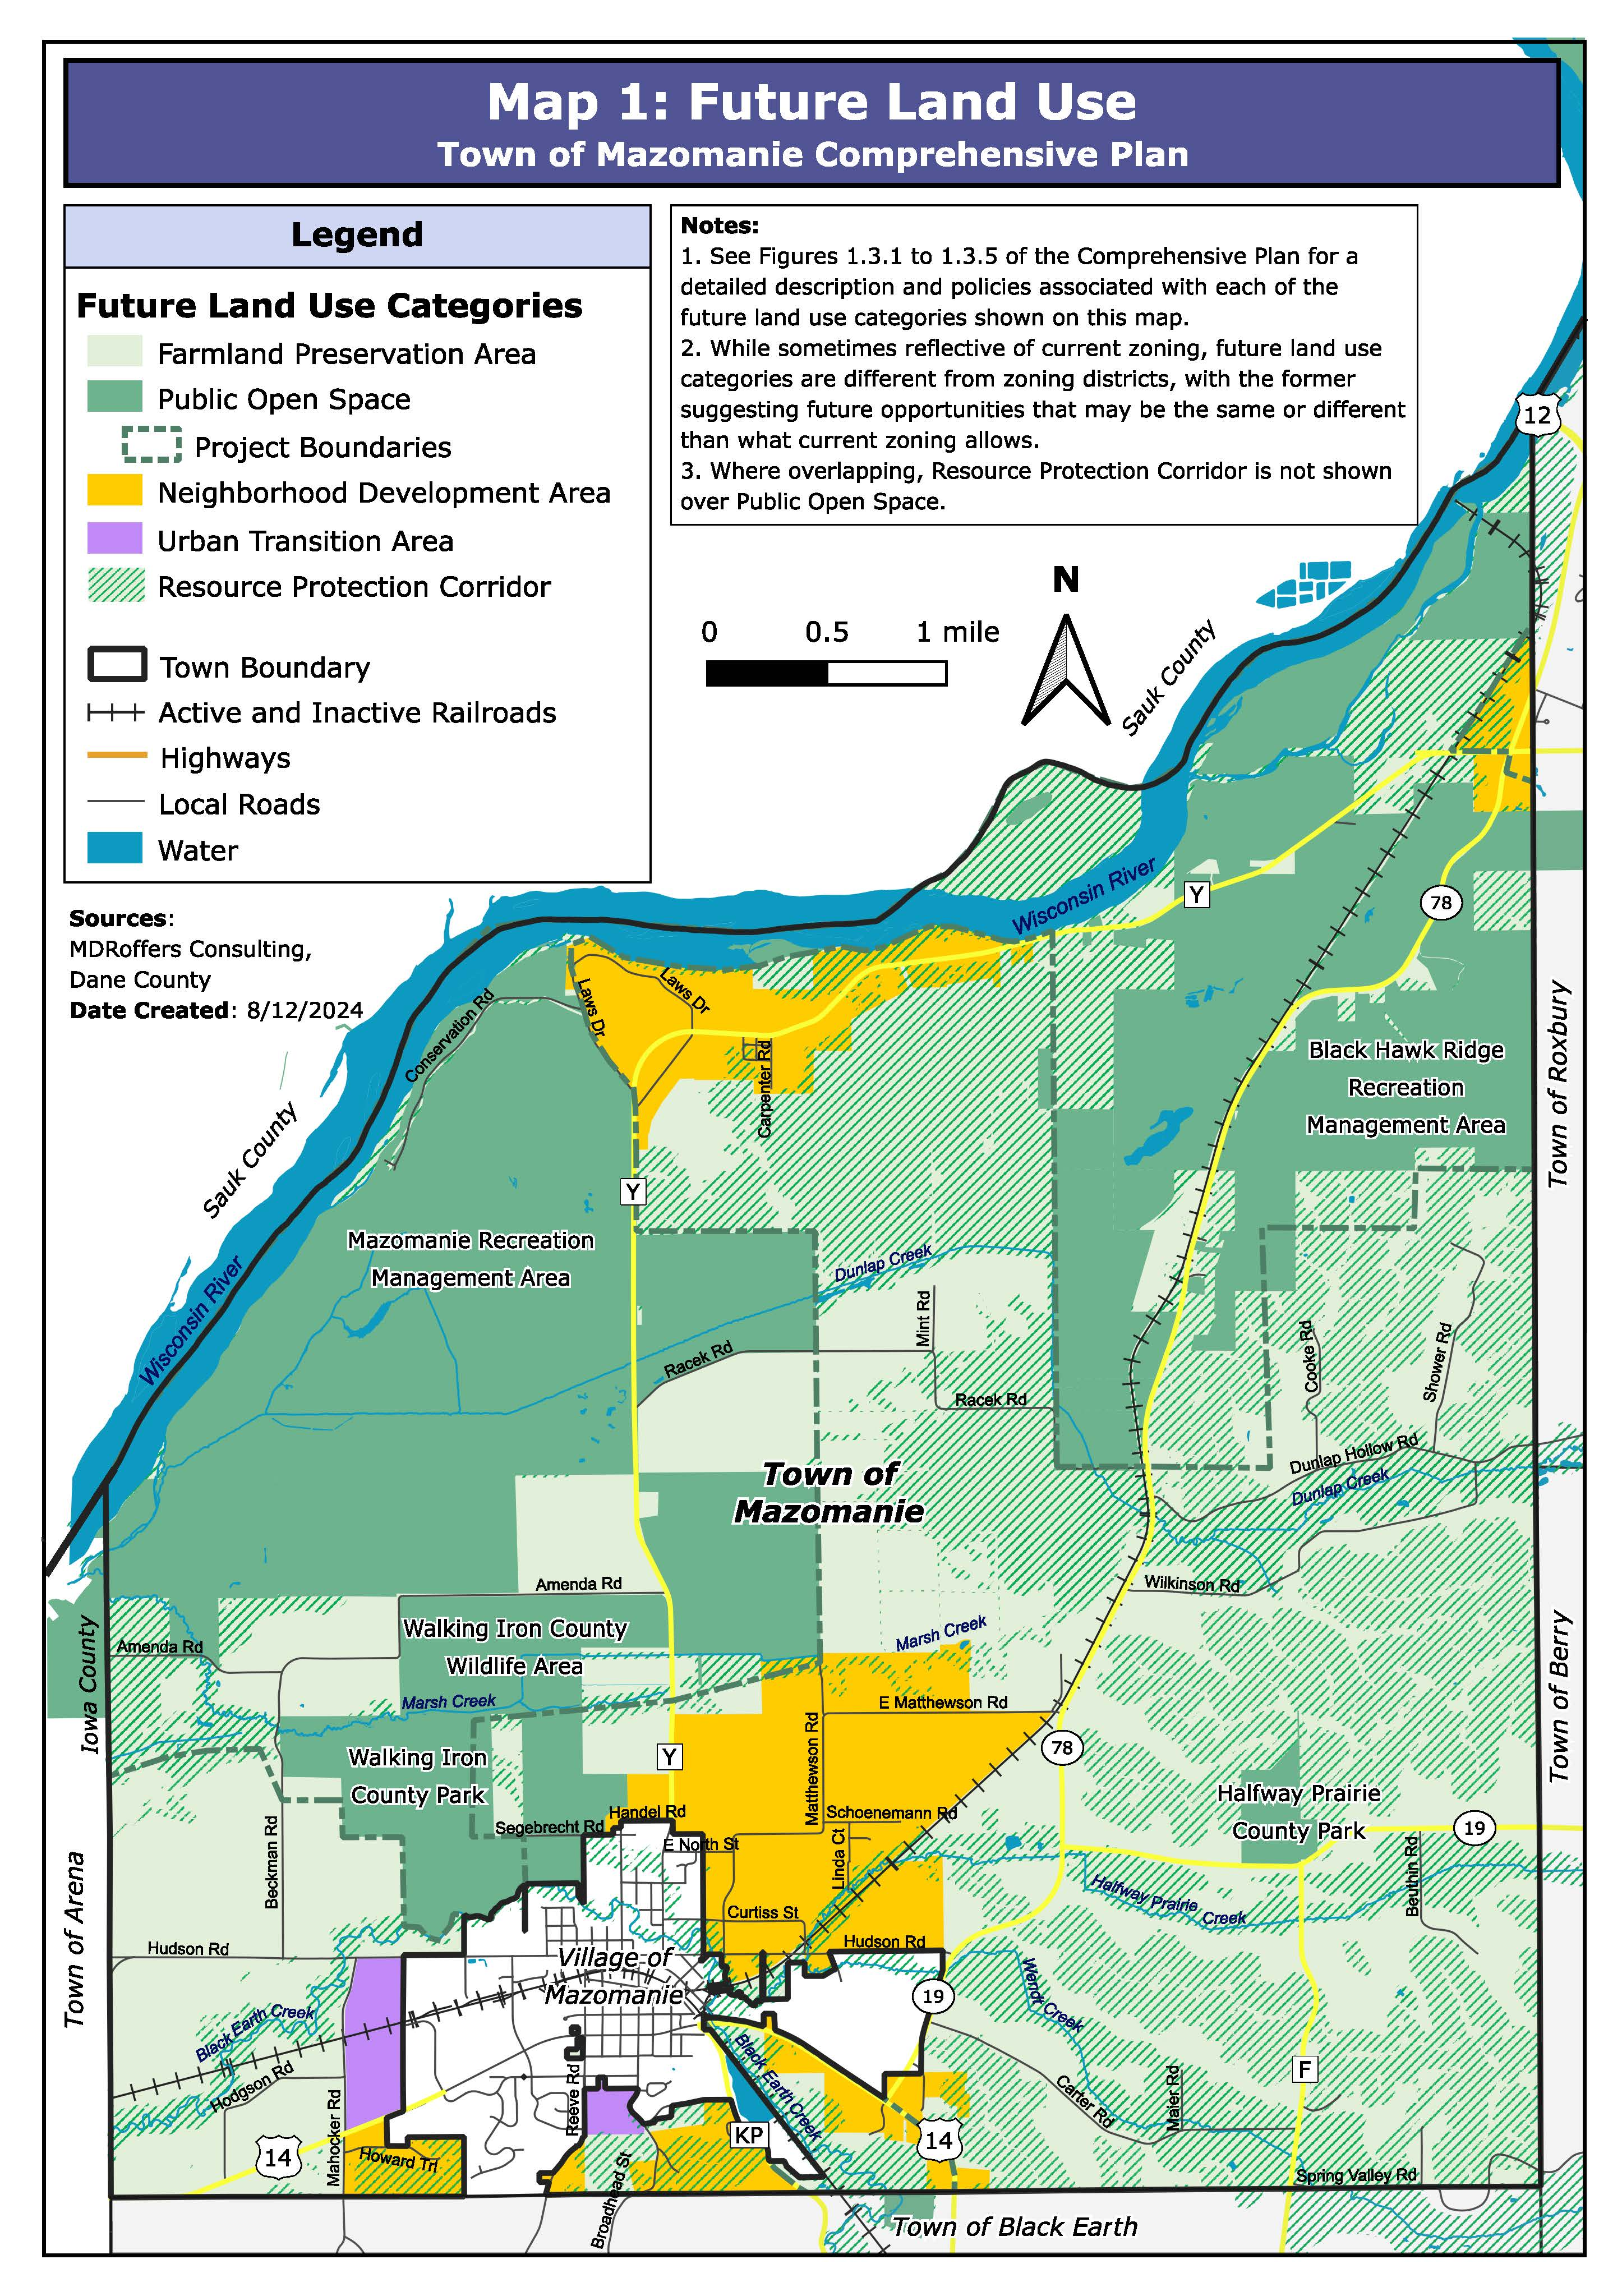
Map Neighborhood Development Area in areas shown on Map 1, using the following criteria:
over and near pre-existing development areas in and near the Town;
away from significant natural resources, environmentally sensitive areas (e.g., steep slopes), and incompatible land uses (e.g., extraction operations, former landfills);
with recognition of the plans of others including the Village of Mazomanie; and
where there is sufficient landowner interest or minimal objection.

Slide 7
Map Neighborhood Development Area in areas shown on Map 1, using the following criteria:
over and near pre-existing development areas in and near the Town;
away from significant natural resources, environmentally sensitive areas (e.g., steep slopes), and incompatible land uses (e.g., extraction operations, former landfills);
with recognition of the plans of others including the Village of Mazomanie; and
where there is sufficient landowner interest or minimal objection.

Slide 8
Lot sizes before/without development rights transfers (+ 1 home per 40 acre density):
Lot sizes following any development rights transfers:

Slide 9
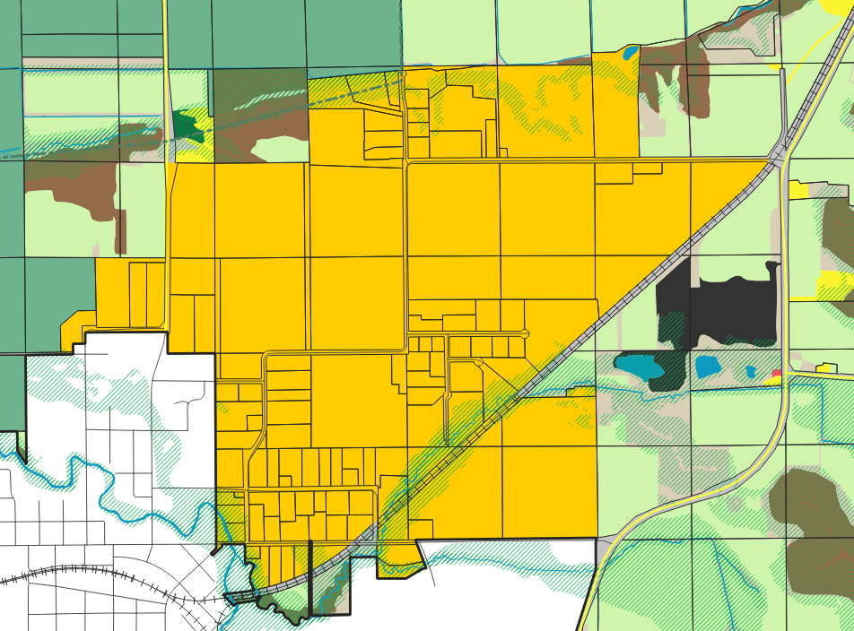

Slide 10
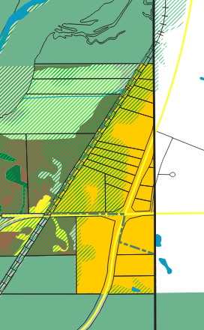
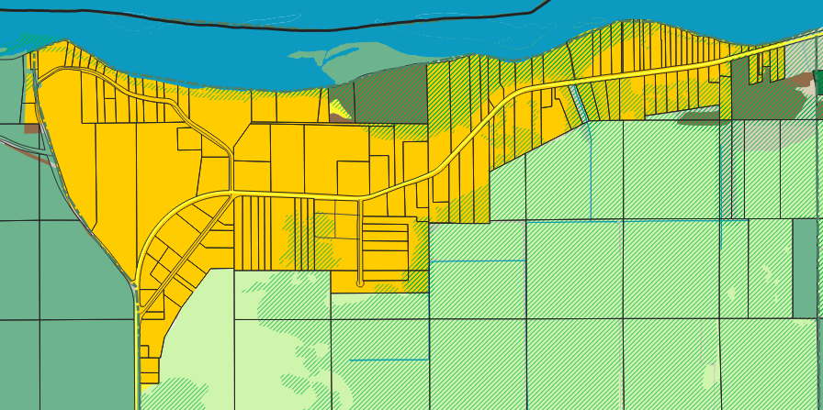

Slide 11
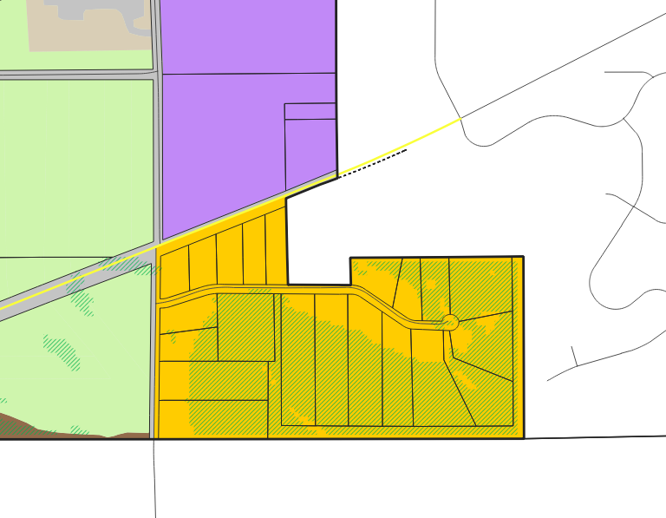
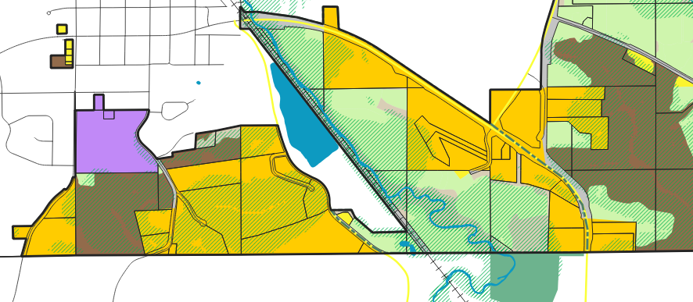

Slide 12
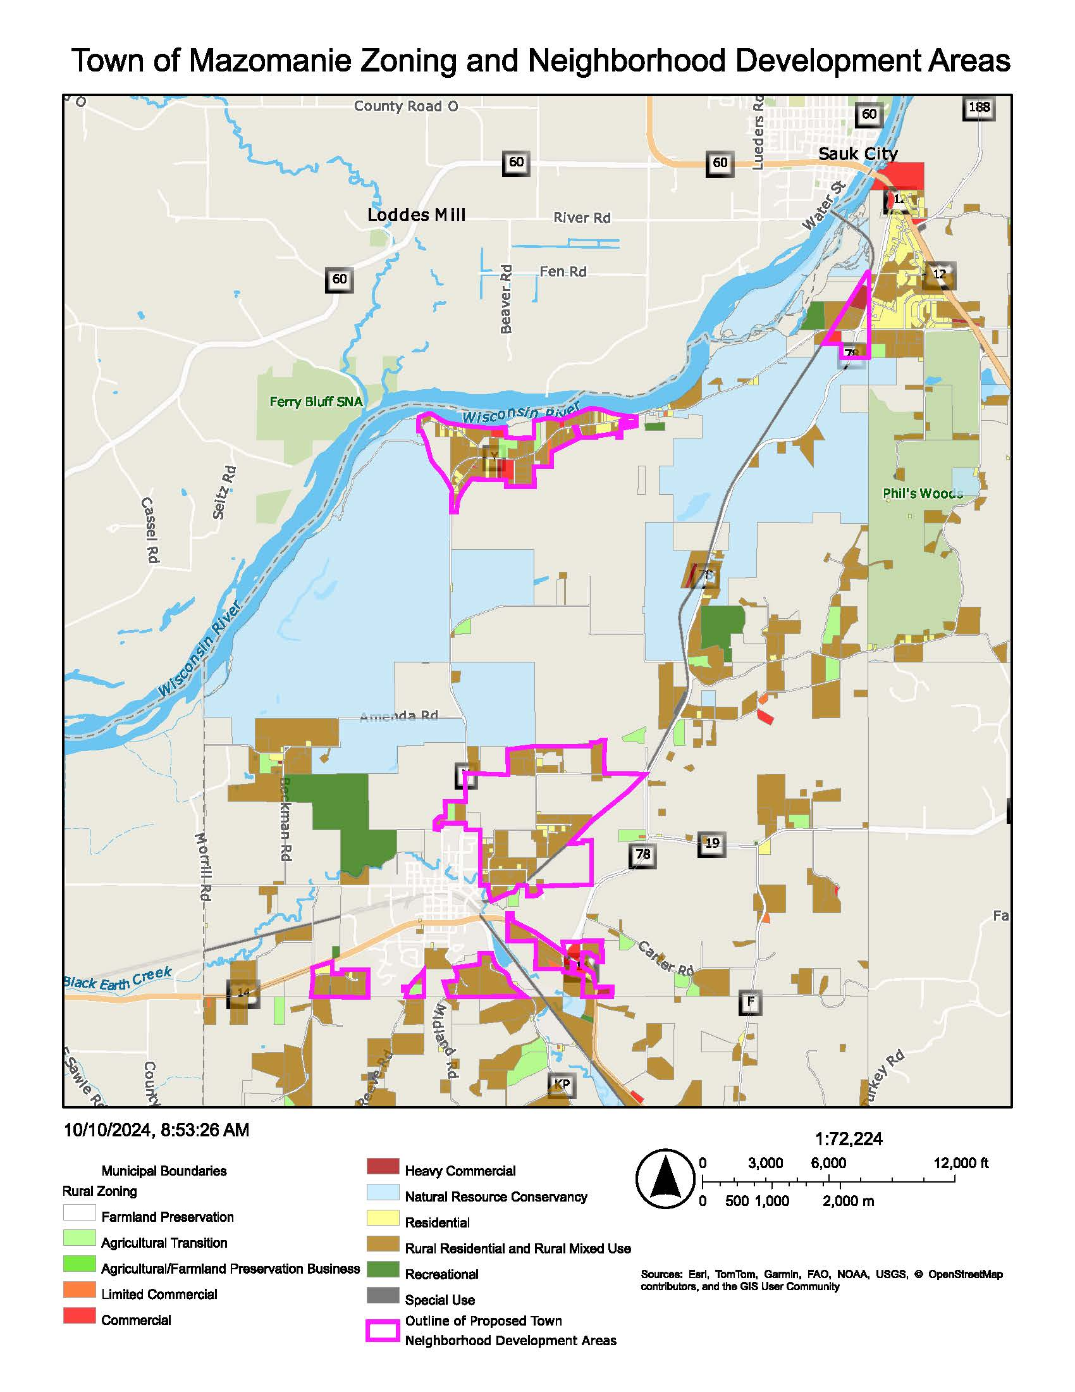
Options for Neighborhood Development Areas (NDAs):
Adopt as proposed.
Adopt with minor adjustments (e.g., adjust transfer ratio, minimum lot sizes).
Do 1 or 2, but also reduce the mapping of NDAs to be over existing residentially zoned areas plus perhaps other parcels with known landowner interest and the right other criteria (e.g., contiguity to zoned areas). Instead, Plan could include criteria for how other parcels in Town might be mapped as NDAs in future. Could be similar criteria used for map proposal.
Keep NDAs only over existing residentially zoned areas, like existing subdivisions and riverfront corridor. Would help with farmland preservation compliance, in which at least 80% of land planned for farmland preservation must be zoned for farmland preservation.
Remove NDA concept entirely from new Plan.

